Slide 1
OPERATING SYSTEM MCS 613 2019
FARHEEN FAISAL SIDDIQUI

Slide 2
What is an Operating System?
A program that acts as an intermediary between a user of a computer and the computer hardware
Operating system goals:
Execute user programs and make solving user problems easier
Make the computer system convenient to use
Use the computer hardware in an efficient manner

Slide 3
Exploits the hardware resources of one or more processors
Provides a set of services to system users
Manages secondary memory and I/O devices

Slide 4
Operating System Definition
OS is a resource allocator
Manages all resources
Decides between conflicting requests for efficient and fair resource use
OS is a control program
Controls execution of programs to prevent errors and improper use of the computer

Slide 5
What Operating Systems Do
Depends on the point of view
Users want convenience, ease of use and good performance
Don’t care about resource utilization
But shared computer such as mainframe or minicomputer must keep all users happy
Users of dedicate systems such as workstations have dedicated resources but frequently use shared resources from servers
Handheld computers are resource poor, optimized for usability and battery life
Some computers have little or no user interface, such as embedded computers in devices and automobiles

Slide 6
Computer System Structure
Computer system can be divided into four components:
1. Hardware – provides basic computing resources
CPU, memory, I/O devices
2. Operating system
Controls and coordinates use of hardware among various applications and users
3. Application programs – define the ways in which the system resources are used to solve the computing problems of the users
Word processors, compilers, web browsers, database systems, video games
4. Users
People, machines, other computers

Slide 7
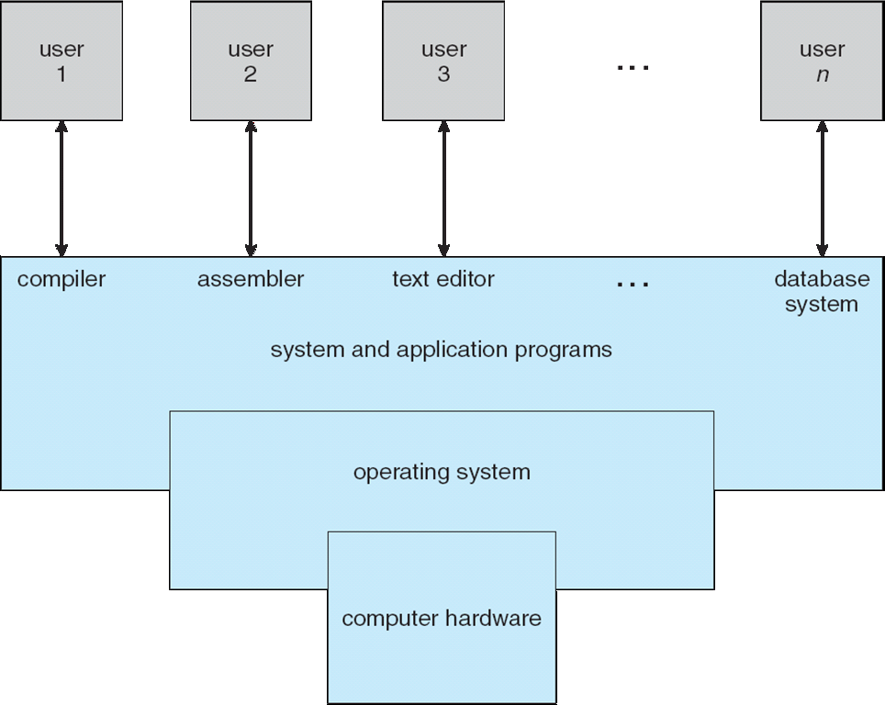
Four Components of a Computer System

Slide 8
Basic Elements
1. PROCESSOR: Controls the operation of computer and perform its data processing function often called CPU
2. MAIN MEMORY Stores data and program
Volatile
Also called real and primary memory

Slide 9
3. I/O MODULE
Move data between the computer and external environment e.g secondary memory disks, Communication Equipment , Terminals.
4. System Bus
Provides for communication among processors main memory and I/O modules.

Slide 10
Processor
Two internal registers
1. Memory address resister (MAR)
Specifies the address for the next read or write
2. Memory buffer register (MBR)
Contains data written into memory or receives data read from memory
I/O address register
Specifies a particular I/O module
I/O buffer register
Used for the exchange of data b/w an I/O module and processor

Slide 11
Processor Registers
User-visible registers
Enable programmer to minimize main memory references by optimizing register use
Control and status registers
Used by processor to control operating of the processor
Used by privileged OS routines to control the execution of programs

Slide 12
User-Visible Registers
May be referenced by machine language
Available to all programs – application programs and system programs
Data
Address
Index register: Adding an index to a base value to get the effective address
Segment pointer: When memory is divided into segments, memory is referenced by a segment and an offset
Stack pointer: Points to top of stack

Slide 13
Control and Status Registers
Program counter (PC)
Contains the address of an instruction to be fetched
Instruction register (IR)
Contains the instruction most recently fetched
Program status word (PSW)
Contains status information

Slide 14
Control and Status Registers
Condition codes or flags
Bits set by processor hardware as a result of operations
Example
Positive, negative, zero, or overflow result

Slide 15
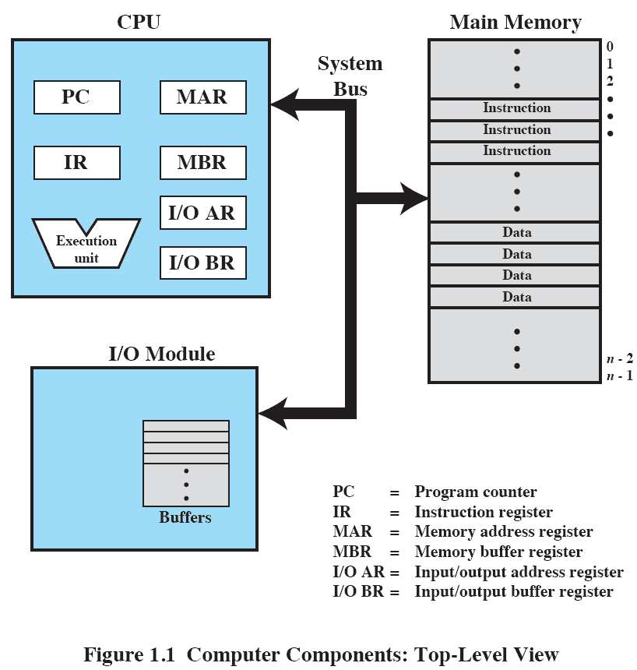
Computer Components: Top-Level View
Processor fn is to exchange data with memory by using registers MAR MBR IOAR and IOBR
Memory module consist of set of locations defined by sequential numbered addresses.
Each location contain a bit pattern that can be interpreted as either data /instruction.
An I/O module transfer data from external device to processor & memory & vice versa, contains internal buffer to temporary stored data.

Slide 16
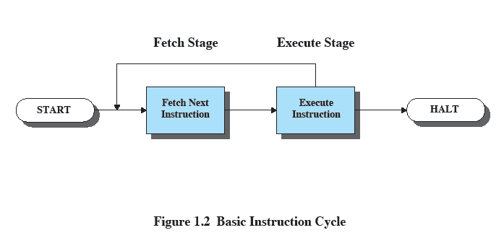
Instruction Execution
Two steps
Processor reads (fetches) instructions from memory
Processor executes each instruction
Basic Instruction Cycle

Slide 17
The processor fetches the instruction from memory
Program counter (PC) holds address of the instruction to be fetched next
PC is incremented after each fetch
Instruction Register
Fetched instruction loaded into instruction register

Slide 18
Multiprogramming
Processor has more than one program to execute
The sequence in which programs are executed depend on their relative priority and whether they are waiting for I/O
After an interrupt handler completes, control may not return to the program that was executing at the time of the interrupt

Slide 19
Computer Startup
1.bootstrap program is loaded at power-up or reboot
Typically stored in ROM or EPROM, generally known as firmware
2.Initializes all aspects of system from CPU register, device controllers to memory contents.
3. Bootstrap know how load the OS and how to execute the system
4. Loads operating system kernel and starts execution

Slide 20
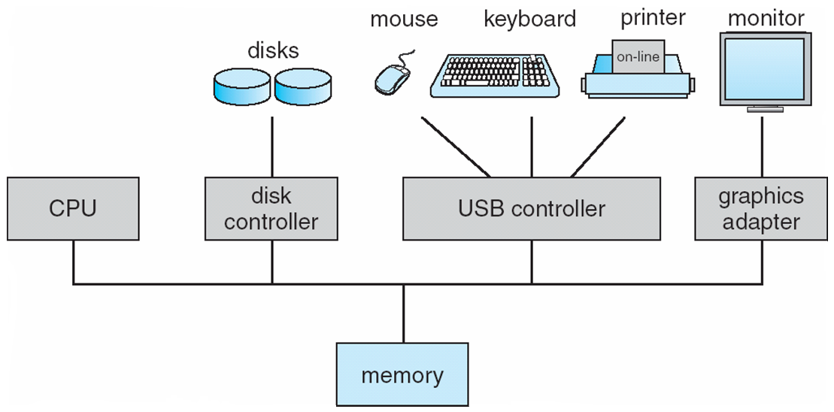
Computer System Organization
Computer-system operation
One or more CPUs, device controllers connect through common bus providing access to shared memory
Concurrent execution of CPUs and devices competing for memory cycles

Slide 21
Computer-System Operation
I/O devices and the CPU can execute concurrently
Each device controller is in charge of a particular device type
Each device controller has a local buffer
CPU moves data from/to main memory to/from local buffers
I/O is from the device to local buffer of controller
Device controller informs CPU that it has finished its operation by causing an interrupt

Slide 22
Interrupts
An interrupt is a function of an operating system that provides multi-process multi-tasking. The interrupt is a signal that prompts the operating system to stop work on one process and start work on another.
Interrupt the normal sequencing of the processor
Most I/O devices are slower than the processor
Processor must pause to wait for device
Interrupt Stage
Processor checks for interrupts
If interrupt
Suspend execution of program
Execute interrupt-handler routine

Slide 23
Interrupts enable software to respond to signals from hardware
May be initiated by a running process
Interrupt is called a trap – software generated caused by error or user request for an OS service
May be initiated by some event that may or may not be related to the running process
Key is pressed on a keyboard or a mouse is moved
Polling is an alternative approach
Processor repeatedly requests the status of each device
Increases in overhead as the complexity of the system increases

Slide 24
Handling Interrupts
After receiving an interrupt, the processor completes execution of the current instruction, then pauses the current process
The processor will then transfer to a fixed location and executes the service routine for the interrupt
The interrupt handler determines how the system should respond
Interrupt handlers are stored in an array of pointers called the interrupt vector
To handle the interrupt quickly, a table of pointers is generally stored in low memory which hold the addresses of the ISR for the various devices
This array, or interrupt vector, of addresses is then indexed by a unique device number to provide the address of the ISR for the interrupting device
After the interrupt handler completes, the interrupted process is restored and execution continues from the address of the interrupted instruction (stored on stack) or the next process is executed

Slide 25
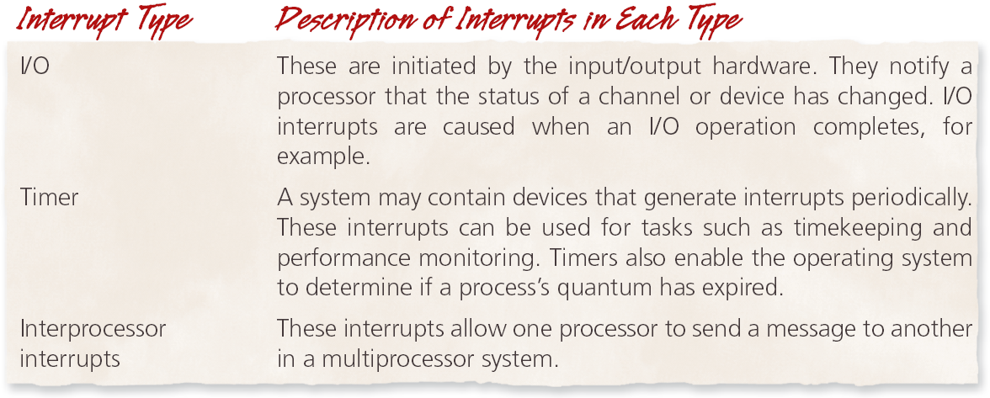
Types of Interrupts

Slide 26
I/O Structure
After I/O starts, control returns to user program only upon I/O completion
Wait instruction idles the CPU until the next interrupt
Wait loop (contention for memory access)
At most one I/O request is outstanding at a time, no simultaneous I/O processing
After I/O starts, control returns to user program without waiting for I/O completion
System call – request to the OS to allow user to wait for I/O completion
Device-status table contains entry for each I/O device indicating its type, address, and state
OS indexes into I/O device table to determine device status and to modify table entry to include interrupt

Slide 27
Storage Structure
Main memory – only large storage media that the CPU can access directly
Random access
Typically volatile
Secondary storage – extension of main memory that provides large nonvolatile storage capacity
Hard disks – rigid metal or glass platters covered with magnetic recording material
Disk surface is logically divided into tracks, which are subdivided into sectors
The disk controller determines the logical interaction between the device and the computer
Solid-state disks – faster than hard disks, nonvolatile
Various technologies
Becoming more popular

Slide 28
Storage Hierarchy
Storage systems organized in hierarchy
Speed
Cost
Volatility
Caching – copying information into faster storage system; main memory can be viewed as a cache for secondary storage
Device Driver for each device controller to manage I/O
Provides uniform interface between controller and kernel

Slide 29
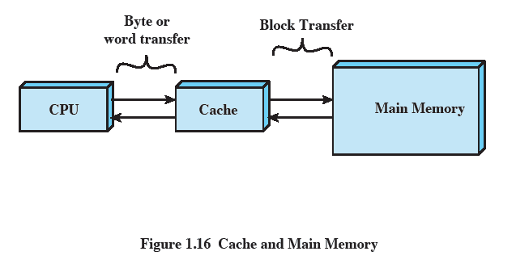
Cache Memory
Use of high speed memory to hold recently access data.
Processor speed faster than memory access speed
Exploit the principle of locality with a small fast memory

Slide 30
Cache Principles
Important principle, performed at many levels in a computer (in hardware, operating system, software)
Contains copy of a portion of main memory
Processor first checks cache
if information is there
If it is, information used directly from the cache (fast)
If not, data copied to cache and used there
Because of locality of reference, it is likely that future memory references are in that block
Cache smaller than storage being cached

Slide 31
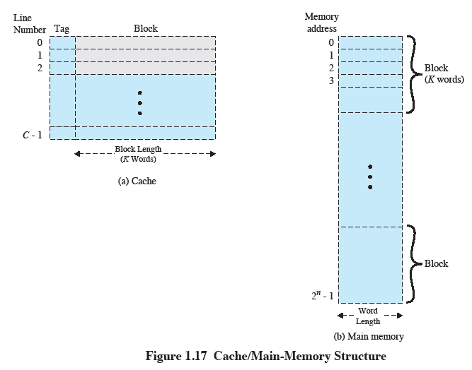
Cache/Main-Memory Structure

Slide 32
Cache Principles
Cache size
Even small caches have significant impact on performance
Block size
The unit of data exchanged between cache and main memory
Larger block size yields more hits until probability of using newly fetched data becomes less than the probability of reusing data that have to be moved out of cache

Slide 33
Mapping function
Determines which cache location the block will occupy
Replacement algorithm
Chooses which block to replace
Least-recently-used (LRU) algorithm
Write policy
Dictates when the memory write operation takes place
Can occur every time the block is updated
Can occur when the block is replaced
Minimize write operations
Leave main memory in an obsolete state

Slide 34
Computer-System Architecture
Most systems use a single general-purpose processor
Most systems have special-purpose processors as well
Multiprocessors systems growing in use and importance
Also known as parallel systems, tightly-coupled systems
Advantages include:
Increased throughput
Economy of scale
Increased reliability – graceful degradation or fault tolerance
Two types:
Asymmetric Multiprocessing – each processor is assigned a specie task.
Symmetric Multiprocessing – each processor performs all tasks

Slide 35
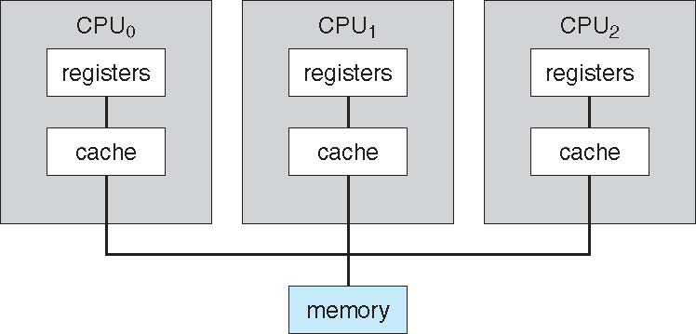
Symmetric Multiprocessing Architecture

Slide 36
Operating System Structure
Multiprogramming (Batch system) needed for efficiency
Single user cannot keep CPU and I/O devices busy at all times
Multiprogramming organizes jobs (code and data) so CPU always has one to execute
A subset of total jobs in system is kept in memory
One job selected and run via job scheduling
When it has to wait (for I/O for example), OS switches to another job
Timesharing (multitasking) is logical extension in which CPU switches jobs so frequently that users can interact with each job while it is running, creating interactive computing
Response time should be < 1 second
Each user has at least one program executing in memory process
If several jobs ready to run at the same time  CPU scheduling
If processes don’t fit in memory, swapping moves them in and out to run
Virtual memory allows execution of processes not completely in memory

Slide 37
Process Management
A process is a program in execution. It is a unit of work within the system. Program is a passive entity, process is an active entity.
Process needs resources to accomplish its task
CPU, memory, I/O, files
Initialization data
Process termination requires reclaim of any reusable resources
Single-threaded process has one program counter specifying location of next instruction to execute
Process executes instructions sequentially, one at a time, until completion
Multi-threaded process has one program counter per thread
Typically system has many processes, some user, some operating system running concurrently on one or more CPUs
Concurrency by multiplexing the CPUs among the processes / threads

Slide 38
Process Management Activities
The operating system is responsible for the following activities in connection with process management:
Creating and deleting both user and system processes
Suspending and resuming processes
Providing mechanisms for process synchronization
Providing mechanisms for process communication
Providing mechanisms for deadlock handling

Slide 39
Memory Management
To execute a program all (or part) of the instructions must be in memory
All (or part) of the data that is needed by the program must be in memory.
Memory management determines what is in memory and when
Optimizing CPU utilization and computer response to users
Memory management activities
Keeping track of which parts of memory are currently being used and by whom
Deciding which processes (or parts thereof) and data to move into and out of memory
Allocating and deallocating memory space as needed

Slide 40
Storage Management
OS provides uniform, logical view of information storage
Abstracts physical properties to logical storage unit - file
Each medium is controlled by device (i.e., disk drive, tape drive)
Varying properties include access speed, capacity, data-transfer rate, access method (sequential or random)
File-System management
Files usually organized into directories
Access control on most systems to determine who can access what
OS activities include
Creating and deleting files and directories
Primitives to manipulate files and directories
Mapping files onto secondary storage
Backup files onto stable (non-volatile) storage media

Slide 41
Mass-Storage Management
Usually disks used to store data that does not fit in main memory or data that must be kept for a “long” period of time
Proper management is of central importance
Entire speed of computer operation hinges on disk subsystem and its algorithms
OS activities
Free-space management
Storage allocation
Disk scheduling
Some storage need not be fast
Tertiary storage includes optical storage, magnetic tape
Still must be managed – by OS or applications
Varies between WORM (write-once, read-many-times) and RW (read-write)

Slide 42
Protection and Security
Protection – any mechanism for controlling access of processes or users to resources defined by the OS
Security – defense of the system against internal and external attacks
including denial-of-service, worms, viruses, identity theft, theft of service
Systems generally first distinguish among users, to determine who can do what
User identities (user IDs, security IDs) include name and associated number, one per user
User ID then associated with all files, processes of that user to determine access control
Group identifier (group ID) allows set of users to be defined and controls managed, then also associated with each process, file
Privilege escalation allows user to change to effective ID with more rights

Slide 43
Computing Environments
1. Traditional
Stand-alone general purpose machines
most systems interconnect with others (i.e., the Internet)
Portals provide web access to internal systems
Mobile computers interconnect via wireless networks
2. Mobile
Handheld smartphones, tablets, etc
Leaders are Apple iOS and Google Android

Slide 44
Computing Environments – Distributed
Distributed computing
Collection of separate, possibly heterogeneous, systems networked together
Network is a communications path, TCP/IP most common
Local Area Network (LAN)
Wide Area Network (WAN)
Metropolitan Area Network (MAN)
Personal Area Network (PAN)
Network Operating System provides features between systems across network
Communication scheme allows systems to exchange messages
Illusion of a single system

Slide 45
Computing Environments – Client-Server
Client-Server Computing
Many systems now servers, responding to requests generated by clients
Compute-server system provides an interface to client to request services (i.e., database)
File-server system provides interface for clients to store and retrieve files

Slide 46
Computing Environments - Peer-to-Peer
Another model of distributed system
P2P does not distinguish clients and servers
Instead all nodes are considered peers
May each act as client, server or both
Node must join P2P network
Registers its service with central lookup service on network, or
Broadcast request for service and respond to requests for service via discovery protocol
Examples include Napster and Gnutella, Voice over IP (VoIP) such as Skype

